Slide 1

PYKV: A SCALABLE IN-MEMORY KEY-VALUE STORE WITH PERSISTENCE

Slide 2
TEAM C
DIVYAPPRIYA S
MANASHI DEBNATH
HARI PRIYAN
SHAIK MAHABOOB BASHA
DEVANSH TANTWAY

Slide 3
INTRODUCTION
  Modern applications require fast data access
  Traditional databases may introduce latency
  In-memory storage provides speed but often lacks durability
  PyKV aims to combine high speed with data persistence

Slide 4
PROBLEM STATEMENT
  In-memory key-value stores are fast but lose data on restart
  Persistent databases are reliable but slower
  Need for a system that:
Stores data in memory
Persists data to disk
Recovers data after crash or restart

Slide 5
PROJECT OBJECTIVES
  Design an in-memory key-value store
  Implement automatic persistence
  Enable crash-safe recovery
  Expose operations through REST APIs
  Provide a simple and clear demonstration

Slide 6
SYSTEM OVERVIEW
  PyKV consists of three layers:
  Core Storage Engine
  Persistence Layer
  API Layer
  Each layer is modular and independent.

Slide 7
ARCHITECTURE
Flow:
  Client → REST API → PyKV Engine → Persistence File
Components:
  API Layer (FastAPI)
  In-Memory Store (Dictionary)
  File Storage (JSON)

Slide 8
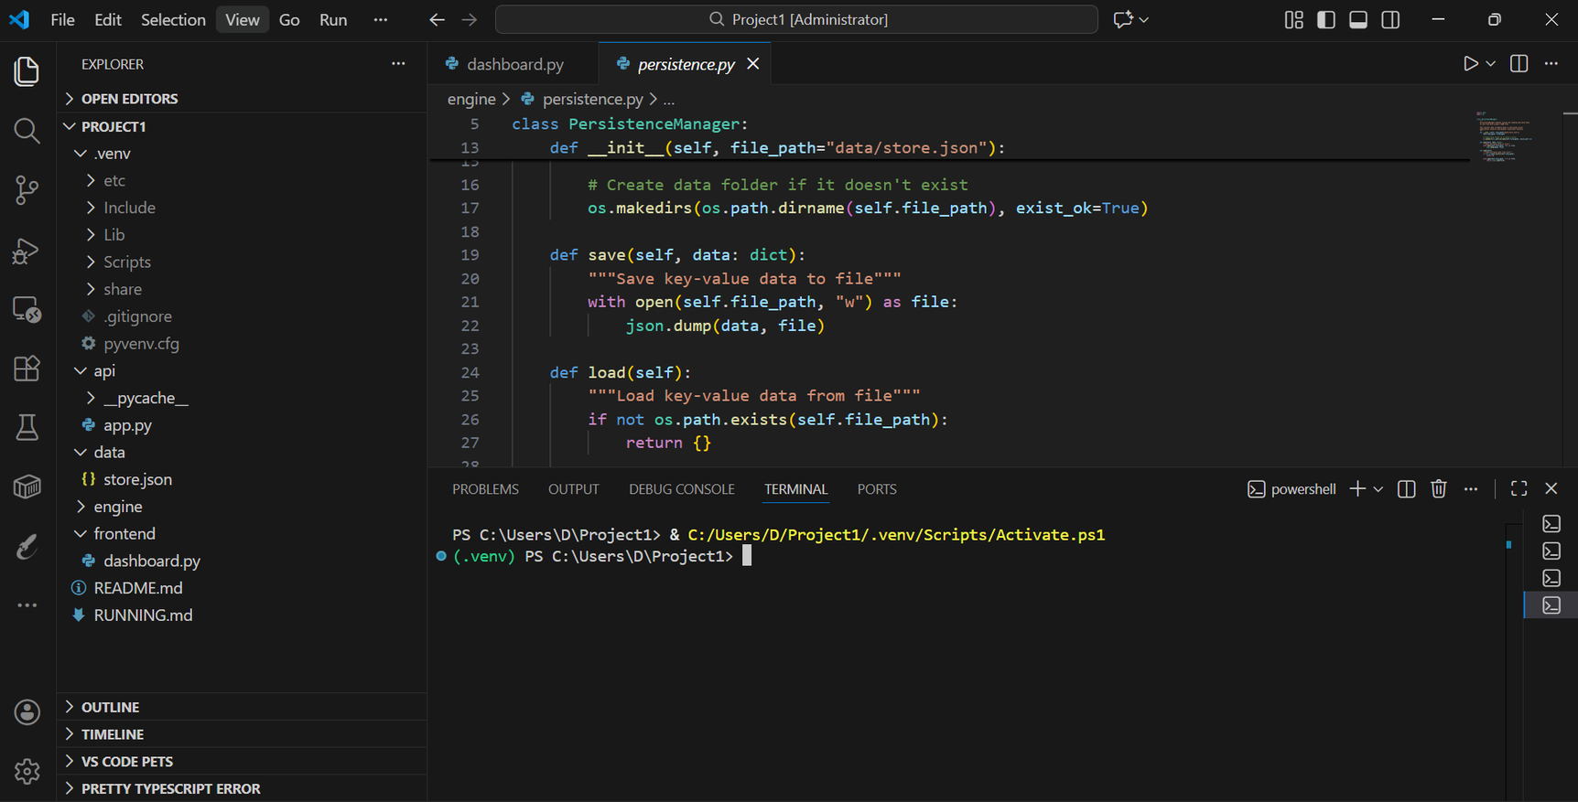
SET UP

Slide 9
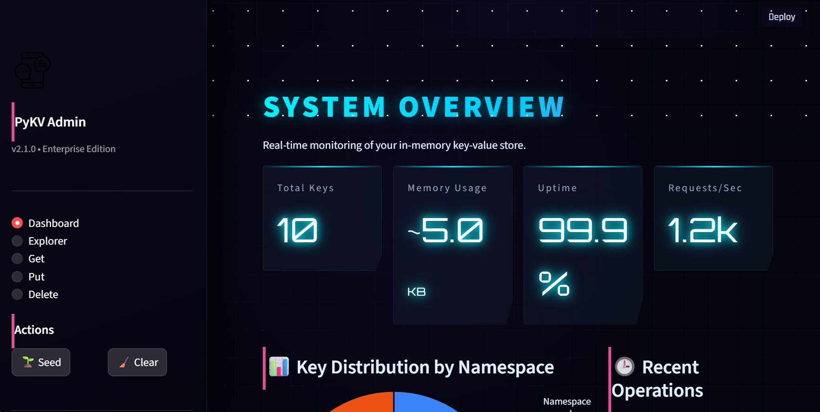
DASHBOARD

Slide 10
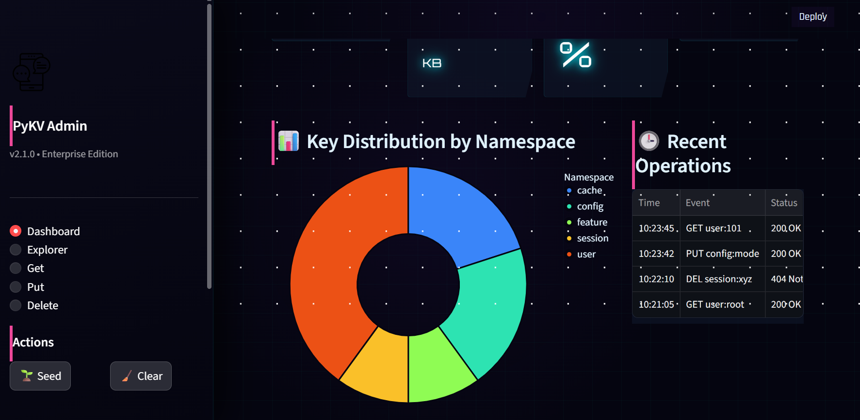
OVERVIEW

Slide 11
CORE ENGINE (IN-MEMORY STORE)
  Implemented using Python dictionary
  Supports:
  PUT (insert/update)
  GET (retrieve)
  DELETE (remove)
  Provides O(1) read and write operations
  Acts as the heart of PyKV

Slide 12
PERSISTENCE LAYER
  Automatically saves data to disk
  Uses JSON file storage
  Data is written:
After every PUT
After every DELETE
  On startup, data is loaded back into memory

Slide 13
API LAYER (FASTAPI)
  Exposes PyKV functionality as REST APIs
  Endpoints:
  POST /put
  GET /get/{key}
  DELETE /delete/{key}
  Frontend : Streamlit

Slide 14
TECHNOLOGIES USED
  Programming Language: Python
  Framework: FastAPI
  Server: Uvicorn
  Storage: JSON file
  Tools: VS Code, GitHub

Slide 15
FEATURES OF PYKV
  High-speed in-memory data access
  Persistent storage
  Crash recovery support
  Modular design
  Easy API-based interaction

Slide 16
DEMO FLOW
  Start the server using Uvicorn
  Insert a key-value pair
  Retrieve the value
  Restart the server
  Retrieve the value again (data persists)

Slide 17
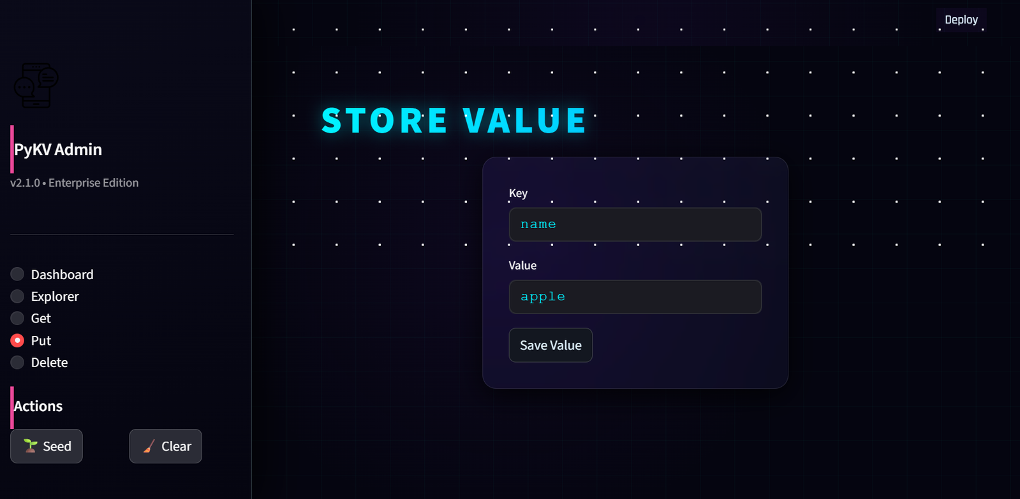
STORE OPERATION

Slide 18
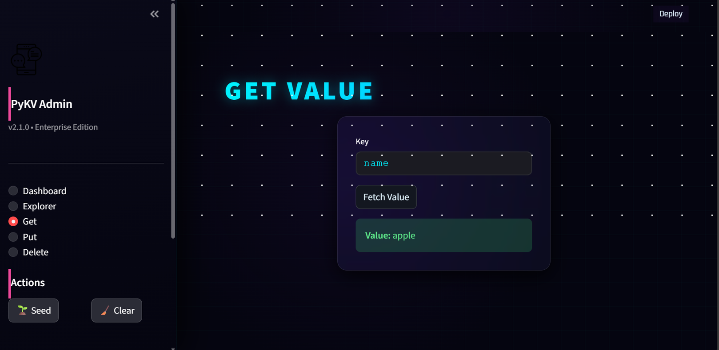
GET OPERATION

Slide 19
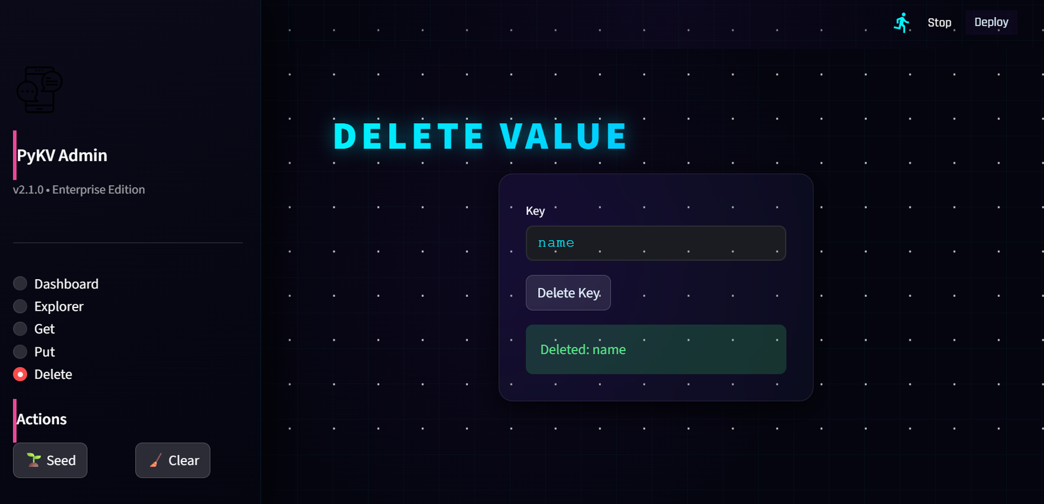
DELETE OPERATION

Slide 20
CHALLENGES FACED
  Python module imports
  Virtual environment configuration
  API debugging
  Data persistence handling
All challenges were resolved through testing and debugging

Slide 21
CONCLUSION
  PyKV successfully combines speed and reliability
  Demonstrates core concepts of backend system design
  Provides hands-on understanding of:
  In-memory storage
  Persistence
  API-based architecture
  Suitable for real-world backend applications

Slide 22
TEAM CONTRIBUTIONS
DIVYAPPRIYA S - Architecture & Core Engine
MANASHI DEBNATH - Persistence Logic
HARI PRIYAN and DEVANSH TANTWAY - API Development
SHAIK MAHABOOB BASHA - Testing & Validation

Slide 23
THANK
YOU

